Slide 1
SDLC models Traditional and Agile
Software Development Life Cycle models
Zoltan_Gal@epam.com
CONFIDENTIAL | © 2019 EPAM Systems, Inc.

Slide 2
Development models
Waterfall model
Need, wish, policy, law
User requirements
System requirements
Global design
Detailed design
Implementation
Testing

Slide 3
Development models
Waterfall model
Everything needs to be defined early.
Sequential flow control.
Hard to push feedback up.
Hardly supports iteration.
Not reactive to changes.
Still with us today.

Slide 4
Development models
V-model
Need, wish, policy, law
Operational system
User requirements
Acceptance test execution
System requirements
System test execution
Global design
Integration test execution
Detailed design
Component test execution
Implementation

Slide 5
Development models
Incremental/iterative models (general)
Splitting up.
Usually equal length phases.
First serves as a base, sets up further phases.
Early release.
Supports early and dynamic feedback.
Cost (early vs. total).
Prototyping.
RAD, RUP.
Agile.

Slide 6
Development models
Phase 1
Define
Develop
Build
Test
Implement
Phase 2
Define
Develop
Build
Test
Implement
Phase 3
Define
Develop
Build
Test
Implement
Incremental/iterative models (general)

Slide 7
Development models
iterative models
Analysis and design
Coding
Testing
Planning
Requirements
Evaluation
Inintial planning
Deployment

Slide 8
Development models
Hybrid incremental model
Need, wish, policy, law
User requirements
Acceptance test execution
System requirements
System test execution
Analysis
Coding
Testing
Integration test execution
WATERFALL
WATERFALL

Slide 9
Development models
Rad - Rapid Application Development
Promotes rapid prototyping
First a prototype is created bases on planning and user design
The prototype can be re-done or changed any number of time, as necessary
The product itself is developed based on the prototype
The final cutover phase takes the product into production
Advantages
Reduced development time
Increases reusability
Early customer feedback
Minimal integration issues
Disadvantages
Only systems that can be modularized can be built using RAD
High dependency on modeling skills
High cost of modeling

Slide 10
Development models
Rad phases
Demonstrate
Refine
Develop
Anaysis and quick design
Testing
Deployment
Protoype lifecycle

Slide 11
Development models
RUP – Rational Unified Process
Belongs to the incremental model family from Rational, a division of IBM.
It helps parallelization of the workforce, for better utilization, so it is useful for the large scale, like hundreds of developers.
Phases
Inception – Determine resource needs.
Elaboration – Architecture and further resource evaluation.
Construction – Design, coding, testing, completing.
Transition – Release, feedback, final updates.

Slide 12
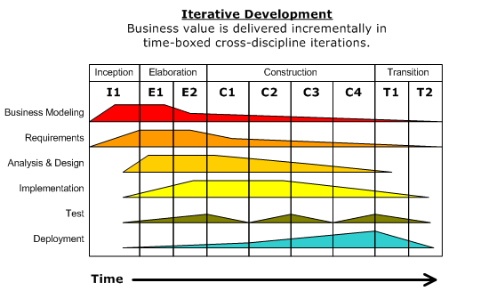
Development models
RUP – Rational Unified Process

Slide 13
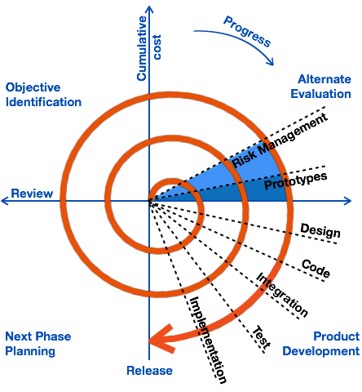
Development models
Spiral model

Slide 14
Development models
Agile manifesto
We are uncovering better ways of developing software by doing it and helping others do it.
Through this work we have come to value:
Individuals and interactions over processes and tools
Working software over comprehensive documentation
Customer collaboration over contract negotiation
Responding to change over following a plan
That is, while there is value in the items on the right, we value the items on the left more.
https://agilemanifesto.org

Slide 15
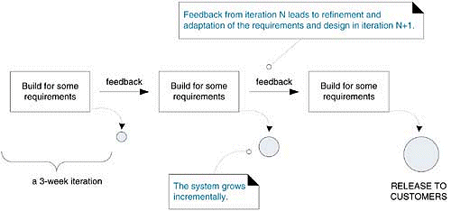
Development models
Agile
“Agile”, the word has been applied around 2001 for building software in a non-traditional way
Features:
low ceremony (fewer procedures, documents)
more effective resource usage
focused on customer and changes
rapid development and feedback
Customer Satisfaction
An approach to building software, in which the overall lifecycle is composed of several iterations in sequence
Each iteration is a self-contained mini-project composed of activities such as requirements analysis, design, programming, and test
The system grows incrementally

Slide 16
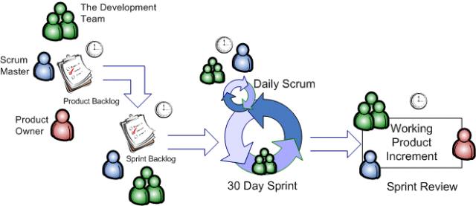
Development models
The scrum method overview

Slide 17

Development models
The scrum - roles
A Pig and a Chicken are walking down the road.
The Chicken says: "Hey Pig, I was thinking we should open a restaurant!„
Pig replies: "Hm, maybe, what would we call it?"
The Chicken responds: "How about 'ham-n-eggs’?”
The Pig thinks for a moment and says: "No thanks. I'd be committed, but you'd only be involved."
PO, SM, development team
Everyone else (managers, user acceptance testers, architects)
vs

Slide 18
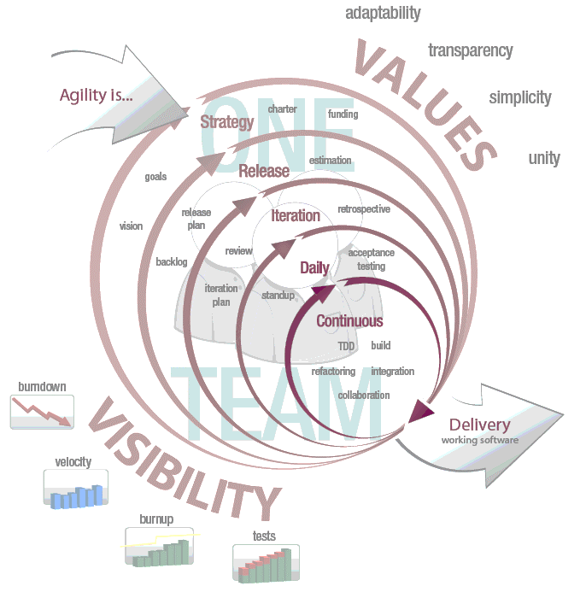
Development models
The scrum method overview
Artifacts
Product Backlog
Sprint Backlog
Product Burn Down Chart
Sprint Burn Down Chart
Daily Scrum Meeting
What did you accomplish yesterday?
What are your working on today?
What impediments in your way?
Sprint Review
Sprint Retrospective Meeting
Time Boxing

Slide 19
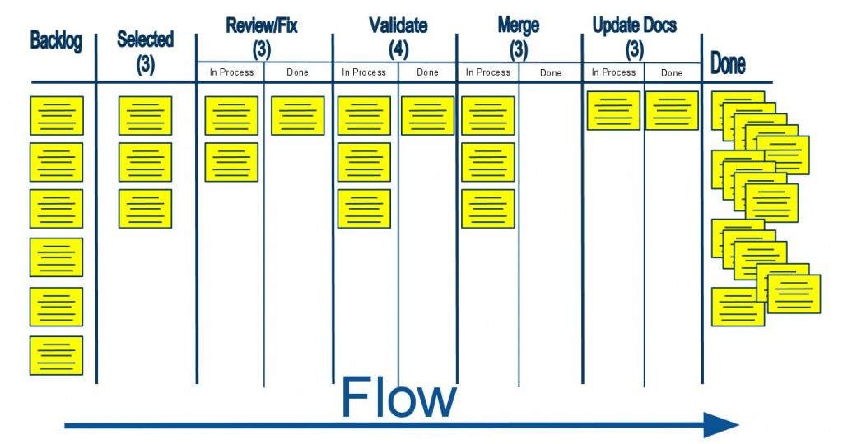
Development models
Kanban

Slide 20
Development models
Fine-scale feedback - Extreme Programming Best Practices – I.
Pair programming – Two people work in tandem on the same problem. Rotating partners is advised.
Planning game – This is how most of the planning for the project takes place.
Release planning – Where determinations are made regarding what is required for impending releases.
Exploration phase – Story cards for the most valuable requirements.
Commitment phase – Planning and commitments from the team.
Steering phase – Adjust previous plans.
Iteration planning – Follows the release planning.
Exploration phase – Requirements are written down.
Commitment phase – Tasks are assigned and scheduled.
Steering phase – Upon development competition results are checked against the original cards.
Test-driven development – Tests are created first based on requirements, only then is code developed against them.
Whole team – Include customers and clients throughout the entire process and use everyone’s feedback.

Slide 21
Development models
Continuous process - Extreme Programming Best Practices – II.
Continuous Integration
All code is merged into one repository (Master).
Integrations tests ensure stability.
Early and frequent integration reveals integration issues at the earliest possible time.
Releases can be assembled in a short time.
Continuous Delivery is the next step.
Code refactoring
Improve and redesign the structure of already existing code.
Behavior should not be modified.
Fixing naming conventions.
Reducing repeated code to a method or function.
Small releases – Release frequently (per hour/day/week/iteration) to show the whole team the current status.

Slide 22
Development models
Shared Understanding - Extreme Programming Best Practices – III.
Coding standards
Set of best practices within the code itself, formatting and style
Applies to everyone who contributes
Promotes better understanding and readability
Ensure continuity for future contributors
Collective code ownership – Everyone should be able to modify all (or at least multiple) parts of the code
Simple design
If there is a choice between simple and complex, always choose the simplest
This applies for components and code snippets as well
KISS – Keep It Simple, Stupid
System metaphor
Everyone in the team should understand the whole system at least on a high level
An easy way to reach this is to have a metaphor to everything, and use it in the naming conventions

Slide 23
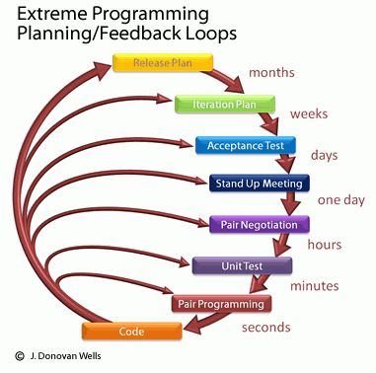
Development models
Programmer welfare Extreme Programming Best Practices – IV.
Sustainable pace
Promotes a healthy work-life balance
No work outside of the normal working hours
No overtimes, no “crunch time”

Slide 24
Pessimistic and optimistic estimation

Slide 25
Why do we estimate?
Why?
We always estimate, time, money, stopping distance, our chances to get a date with the desired boy/girl, and everything
We use these estimations for making decisions about
Investing in something, or skipping it
Deciding between multiple options
Who?
Estimations can be done solo, or in a group
Group estimations might include
People who are to realize the task if it needs to be done
Experts who have done it more times than us
The 2nd party, as an observer, or to provide details
Difficulties?
Quite hard to estimate the unknown
Not easy to be pessimistic
Estimation time is always used up
Managers think of it as the Holy Writ
Not everything is estimated
Too many plans rely on estimates
People are not universal
Changes are often not re-estimated
The skeleton falls out too late
Failures do not trigger re-estimation
Wrong people do the estimates

Slide 26
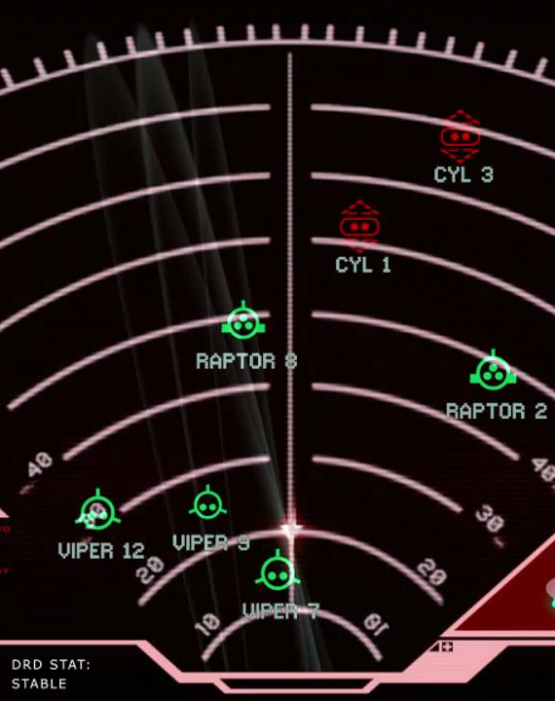
Popular estimation techniques
Planning Poker
Three Amigos / Triad
T-Shirt Sizes
Three-Point / PERT
And many more…

Slide 27

Three-Point Estimation
It is also called PERT, as Program Evaluation and Review Technique
It provides three points (no sh*t, Sherlock)
Pessimistic (b)
Realistic (m)
Optimistic (a)
Benefits
Increased accuracy
Risks are considered early
Risks are shared early
Funky mathematics to go with it
Double-triangular distribution
E = (a + 4m + b) / 6
SD = (b − a) / 6
Triangular distribution
E = (a + m + b) / 3

Slide 28
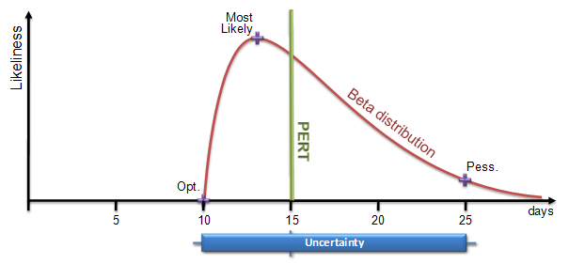
Three-Point Estimation
A Cool Graph
A boring sample of magic
For e.g.
If optimistic estimate to finish a module is 12 days, most likely is 16 days and pessimistic estimate is 18 days , the 3 point estimate is
(12 + 4 * 16 + 18)/6 = 15.67 and spread is (18-12)/6 = 1.
This in turn means 95 % probability is that module will finish by 13.67 to 17.67 days (+/- 2 days for 2 sigma level)
Also, if we go by 99% probability or 3 sigma , the spread is +/- 3 days of mean estimate…
For day to day projects, 95% confidence level is good. For mission critical projects, go for 99%. Also, since spread at 95% is +/-2 days or of 4 days, the risk is of 4/15.67 = 0.25 or 25%.

Slide 29

Pessimistic and Optimistic Estimation
The key is simplification
Three points -> Two points
Pessimistic (p)
Optimistic (o)
Fibonacci -> Man-days
It might already be ready, and easily available (0, 0.5)
We need to work on it (1, 2, 3, …)
Simple mean (m) calculation
m = (p + o) / 2
Adding contingency (c) in one go
c = 0.2 * m
Finalize (f) by simply adding them together
f = m + c
You call this simple?!
This has a lot of math still!
Show me an example!

Slide 30
Pessimistic and Optimistic Estimation example
Task | Summary | O | P | M | C | F
TMNT-0001 | Create test report for Sprint 23 | 3 | 5 | 4 | 1 | 5
TMNT-0002 | Review requirements for Sprint 24 | 4 | 7 | 5.5 | 1.4 | 6.9
TMNT-0003 | Reclaim Cybertron | 2 | 9 | 5.5 | 1.8 | 7.3
TMNT-0004 | Expand smoke suite with Sprint 22 items | 5 | 10 | 7.5 | 2 | 9.5
TMNT-0005 | Test design for the multiple document view feature | 2 | 3 | 2.5 | 0.6 | 3.1
TMNT-0006 | Avenge the death of Alex J. Murphy | 7 | 11 | 9 | 2.2 | 11.2
TMNT-0007 | Create ramp-up plan for new the new team member | 3 | 7 | 5 | 1.4 | 6.4
TMNT-0008 | Bring swift death to the enemies of Mankind | 1 | 4 | 2.5 | 0.8 | 3.3
TMNT-0009 | Update test set user info for the new environment | 5 | 7 | 6 | 1.4 | 7.4
SUM |  | 32 | 63 | 47.5 | 12.6 | 60.1

Slide 31
T-Shirt Size Technique
It’s one of the Agile Story Point Estimation Techniques.
It’s a relative estimation technique.
Based on the US t-shirt sizes: Small (S), Medium (M), Large (L) and Extra Large (XL) and so on.
Smaller than XS = a Task, Larger than XL = an Epic.
Allows a more dynamic approach.
PO explains, then questions follow:
Design-related: e.g. Do we have to learn new things before starting the design/HTML/jQuery etc?
Coding-related: e.g. Do we have any code class library ready or we have to write it from the scratch?
Testing-related: e.g. Any specific setup required for testing?
After everyone showing their chosen t-shirt size, the team might need to debate, and redo the exercise.
One of the smallest t-shirt size showers should explain why.
One of the largest t-shirt size showers should explain why.
After all items are done, place them in their respective buckets.

Slide 32
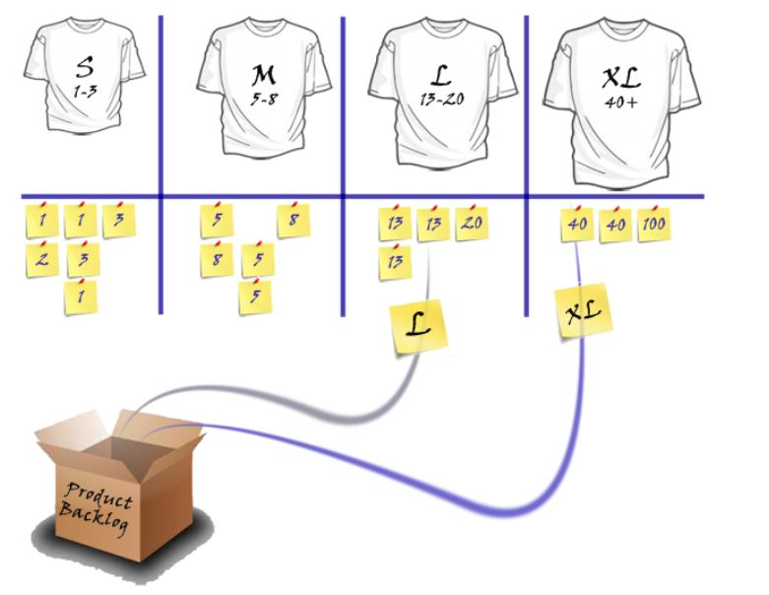
T-Shirt Size Technique

Slide 33
Useful AGILE links
Scrum Alliance - http://www.scrumalliance.com
Mountain Goat Software - http://www.mountaingoatsoftware.com
Agile Alliance - http://agilealliance.com
VersionOne - http://www.versionone.com/Agile101/
EPAM Agile Professional Development Suite - https://www.epam.com/our-work/brochures/agile-professional-development-suite

Slide 34
“To question is to doubt” Imperial thought for the day
Thank you For your attention!
Zoltan_Gal@EPAM.com

